Slide 1
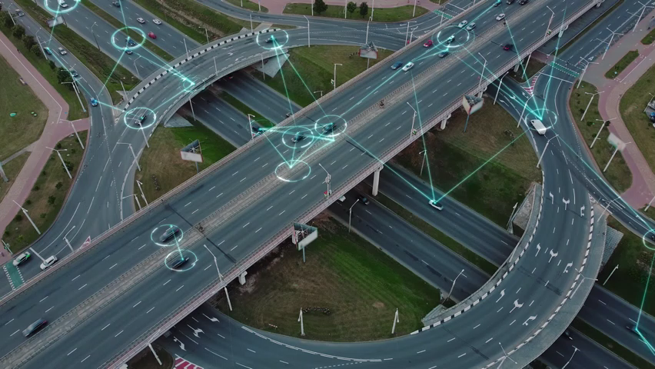
Is Washington State Ready for the EV Revolution?
By: Esha Patel, Jeff Morgan, Ipsita Pattanaik, Neil Lawren, Smita Shah
Notes:
GOOD EVEING THIS IS JEFF MORGAN FOR OUR GROUP PROJECT WE CHOSE TO ASK THE QUESTION.
IS WASHINGTON STATE READY FOR THE EV REVOLUTION?
I WILL BE JOINED BY MY GROUP MATES ESHA PATEL, IPSITA PATTANAIK, NEIL LAWREN AND SMITA SHAH.
LET GET INTO IT SHALL WE?

Slide 2
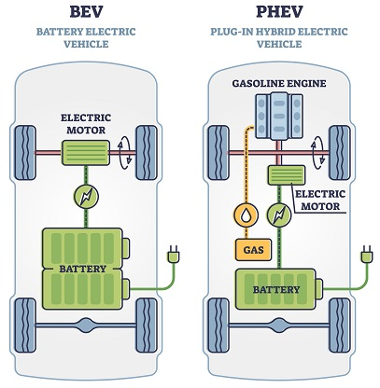
ELECTRIC VEHICLES
WHAT ARE THEY?
BATTERY
ELECTRIC
BEV
WHAT ARE THEY?
HYBRID
GAS + ELECTRIC
PLUG IN ELECTRIC
PHEV
Notes:
Electric vehicles, are this centuries attempt to not to reinvent the wheel, but to move the wheel more efficiently, while reducing both our impact on the climate and our dependency on fossil fuels.
Electric vehicles currently are available in several types, battery powered only, which requires and external power source to charge the battery. Second, the Plug-in-Hybrid EV which has a battery as its main source of power that CAN be charged from an external power source and is also supported by an internal combustion engine.
Finally, the Hybrid which is powered primarily by an internal combustion engine and supported by a battery that charges while the vehicle is in use and does not offer using an external power source.

Slide 3
Data Sources Used
CHARGING LOCATIONS
HTTPS://RAPIDAPI.COM/LETSCRAPE-6BRBA3QGUO5/API/EV-CHARGE-FINDER
TAX INCENTIVES 2023
HTTPS://FUELECONOMY.GOV/FEG/TAX2023.SHTML
WASHINGTON STATE DATA
HTTPS://CATALOG.DATA.GOV/DATASET/ELECTRIC-VEHICLE-POPULATION-DATA
Notes:
We have found these data sources for our project.
The Rapid API to find charging locations in the state of Wshingtom
Fuel Economy.GOV for tax incentives and rebates available
As well, catalogdata.GOV for the number of electric vehicles registered in the state of Washington

Slide 4

3 Sub-Questions Asked
3 Sub-Questions Asked
QUESTION 3
What are the most popular car models in the selected cities, and do they have federal incentives?
QUESTION 2
What is the ratio of cars to chargers in the selected cities and the charging speeds available?
QUESTION 1
Which cities in Washington have the most electric and hybrid cars registered?
Notes:
As we did our research. we discovered many considerations regarding EV’s, these three questions stood out to our group.
One, which cities in Washington had the most registered EV’s?
Two, the ratio of chargers to vehicles and what were the speed of those chargers?
Lastly, were tax incentives or rebates available on the most popular EV purchased?
I will now turn it over to my group mates to dive into those questions

Slide 5
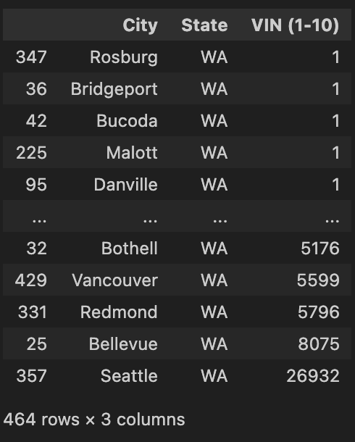
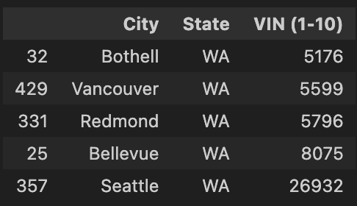
Question 1: Which cities in Washington have the most electric and hybrid cars registered?
Notes:
Let us take look at our first question.
Which cities in Washington have the most electric and hybrid cars registered?
We found over 159 thousand rows of data for Washington State.
We grouped them, by city, which provided us, 464 rows of data,
Providing the total number of Battery, Plug-In Hybrids and Pure Hybrids registered per city.
We decided, it was best, to compare the top 5 cities with the most data on Evs, and discovered that the cities of Bothell, Vancouver, Redmond, Bellevue, and Seattle, gave us the most insight.

Slide 6
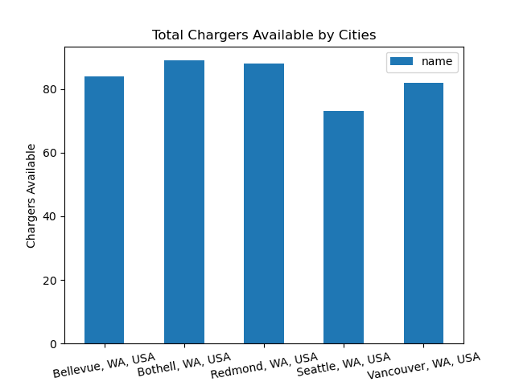
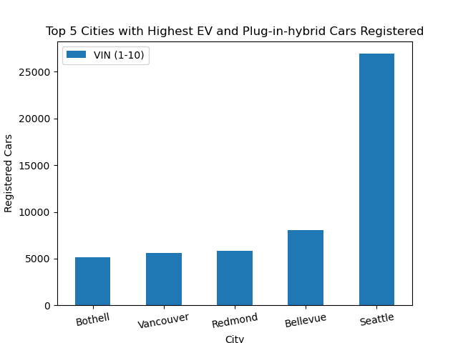
Top 5 cities and the number of registered cars.
The total chargers available in the top 5 cities.
Notes:
OUR CHART SHOWS THAT BOTHELL, VANCOUVER AND REDMOND BELLEVUE ARE FAR BEHIND SEATTLE
THE CHART ON THE RIGHT THE TOTAL NUMBER OF CHARGERS AVAILABLE PER CITY.

Slide 7
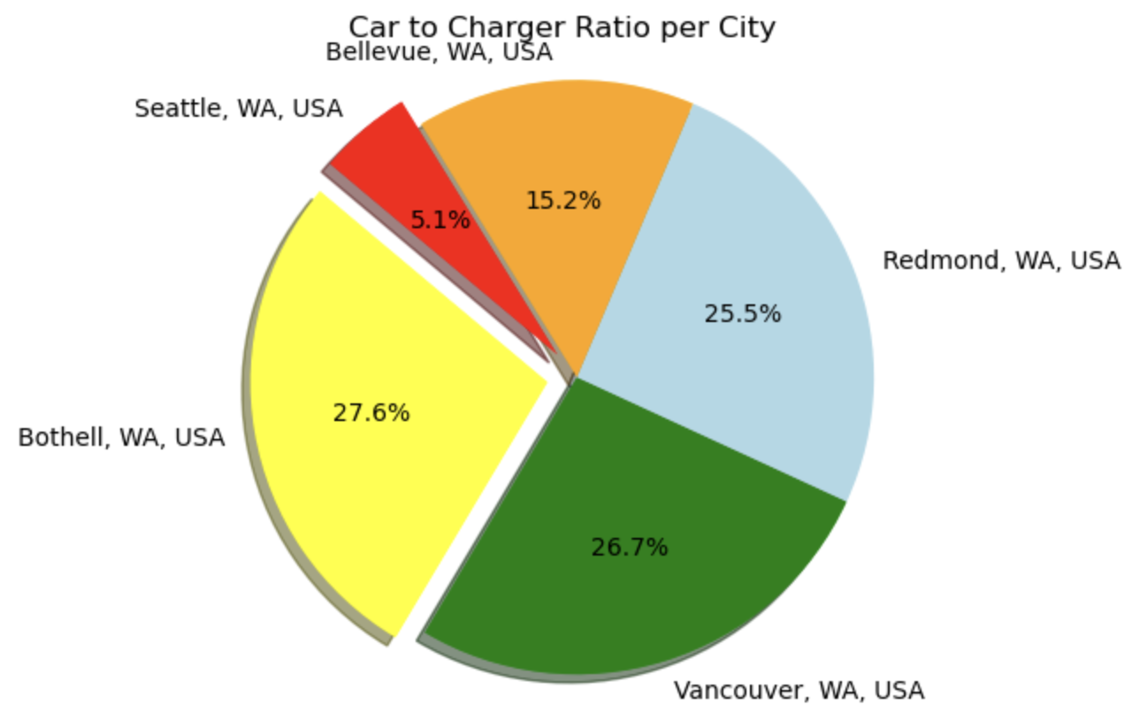
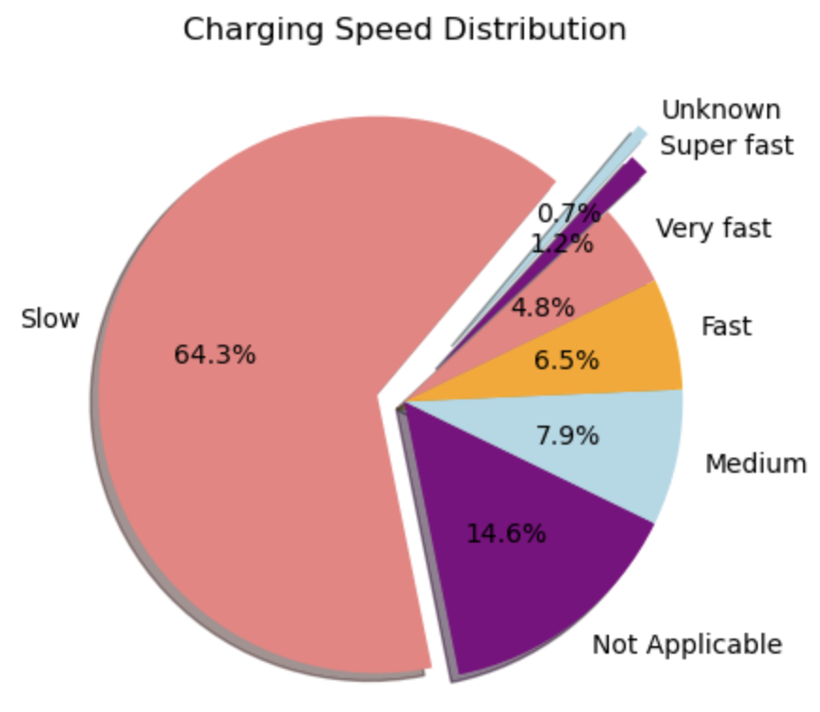
Question 2: Ratio of cars to chargers & charger speeds?
Notes:
We looked into both the car to charger ratio, and the charging speeds available to the consumer.
As you can see there is a difference between the top cities and the percentage of chargers available.
It was surprising to see that mostly, only, SLOW charging options were available to the consumer in the cities with the most electric cars.

Slide 8
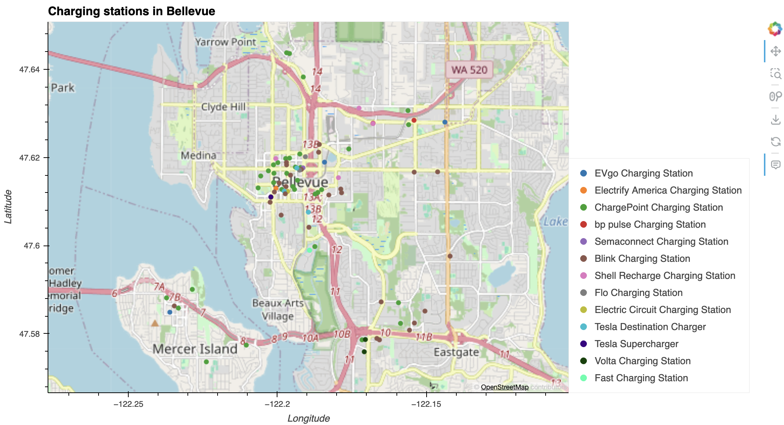
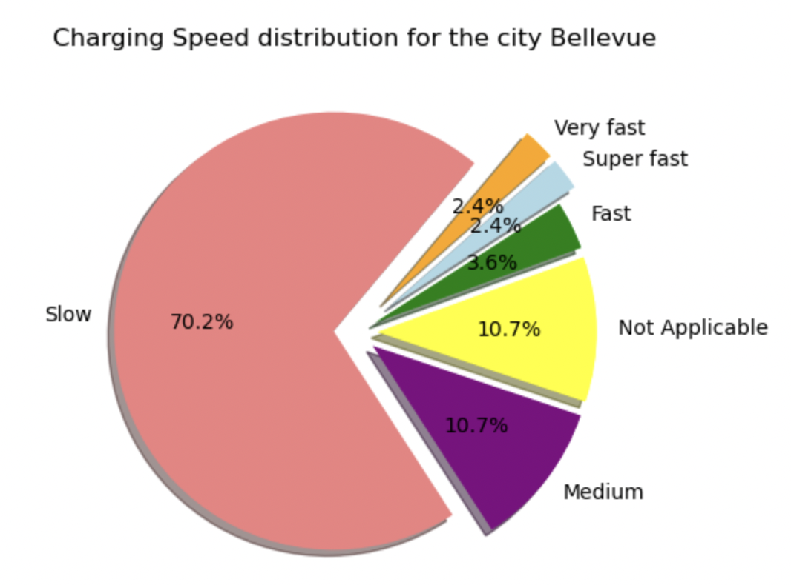
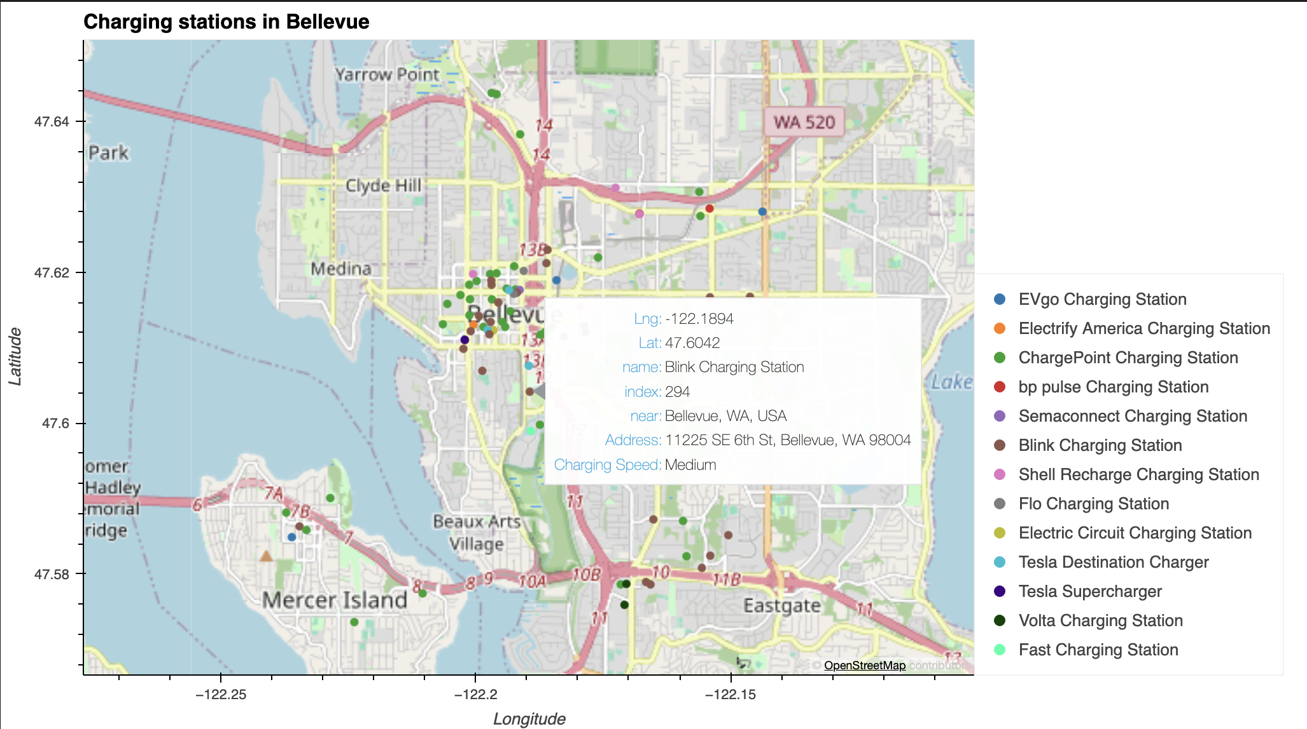
Charging Stations near Bellevue, WA
Notes:
For the top cities, lets start with Bellevue.
The map shows the number of charging station in the citi.
On the map if you hover over any particular location it will give the details about the location, address, name, charging speed, longitude, latitude of the selected charging station
As you can see in Bellevue the majority of chargers offer SLOW charging
Bellevue is 70.60% slow charging station vs. only 2.4% of very fast charging
And on the other side the map shows all the charging station in Bellevue.

Slide 9
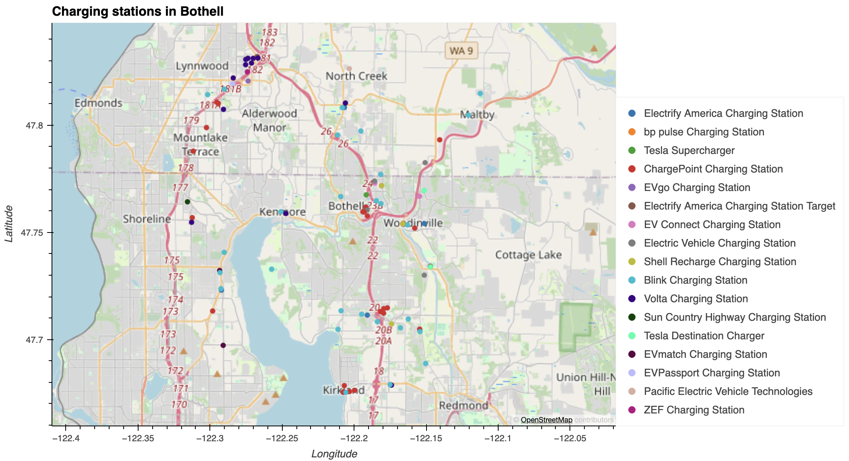
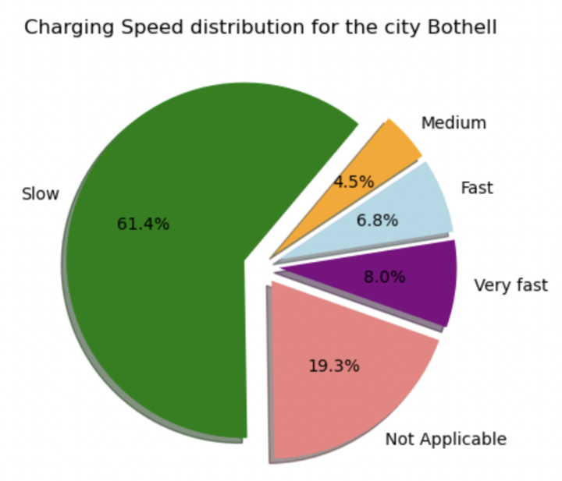
Charging Stations near Bothell, WA
Notes:
Similarly in Bothell pie chart has 61.8% slow charging station vs. 7.9% for very fast charging station
And on the other side the map shows all the charging station in Bothell

Slide 10
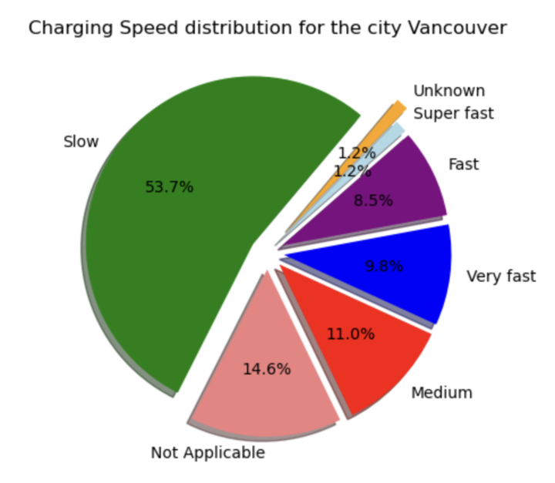
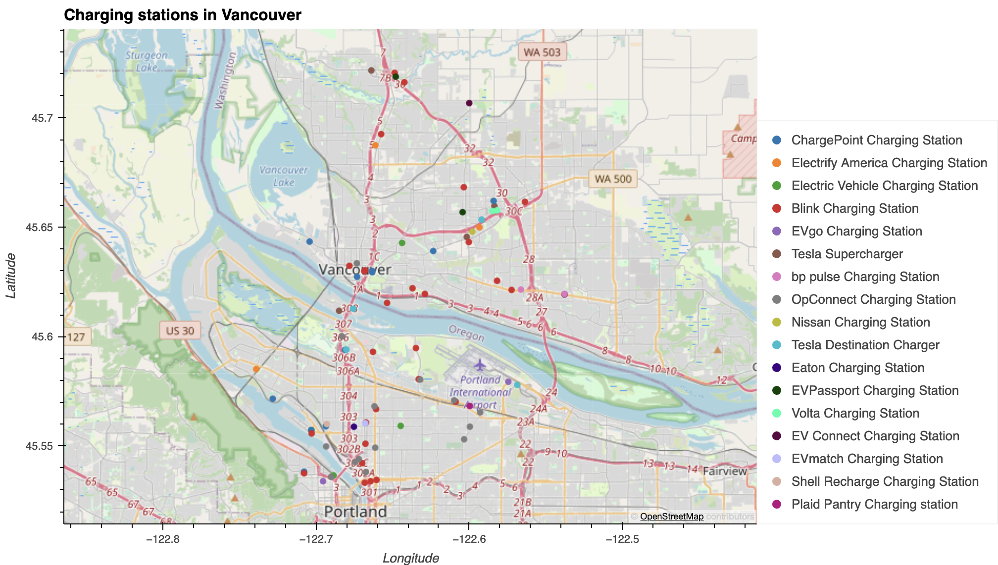
Charging Stations near Vancouver, WA
Notes:
However in Vancouver pie chart has 52.4% slow charging station vs. 1.2% for super fast charging station
And on the other side the map shows all the charging station in Vancouver

Slide 11
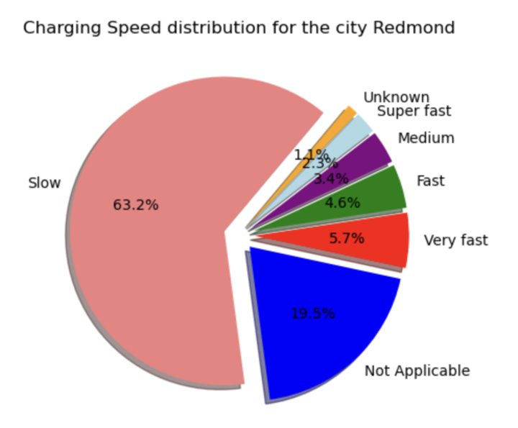
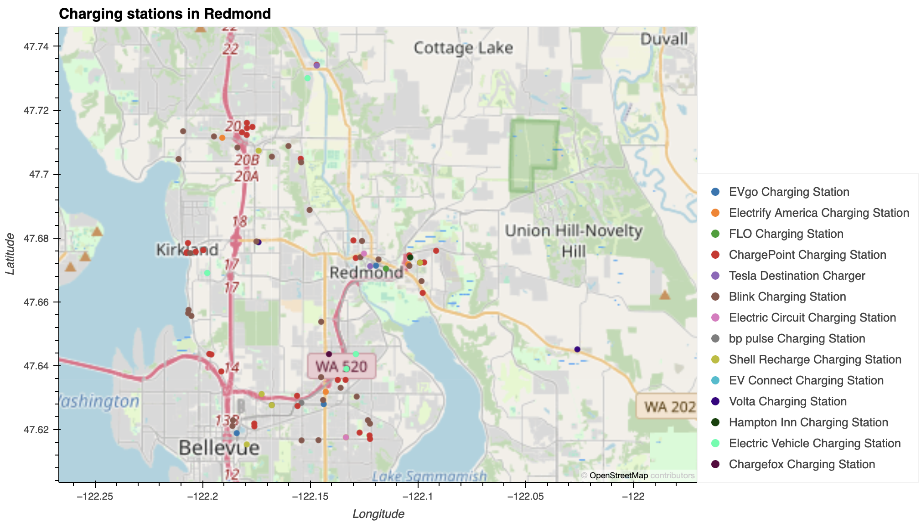
Charging Stations near Redmond, WA
Notes:
Moving on to Redmond, pie chart has 64.8% slow charging station Vs. 4.5% for very fast charging station
And on the other side the map shows all the charging station in Redmond.

Slide 12
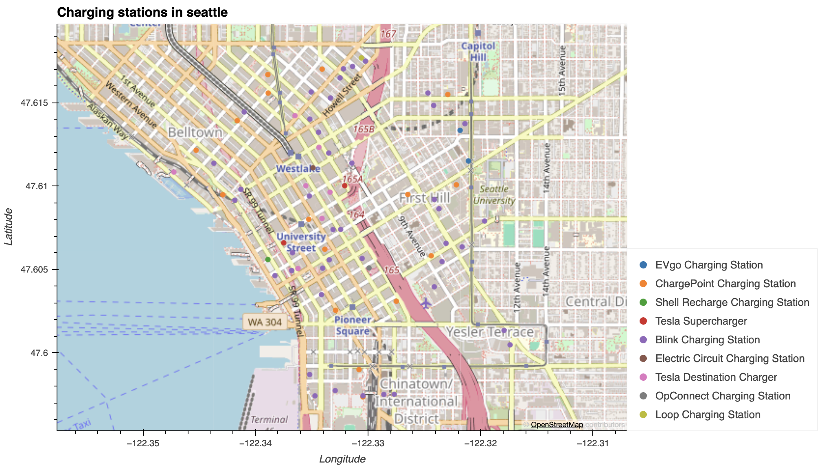
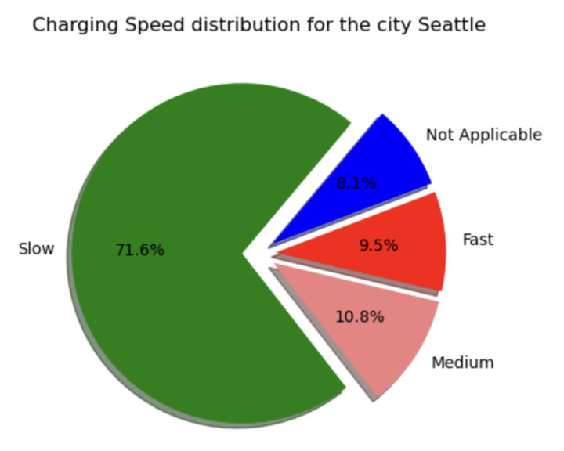
Charging Stations near Seattle, WA
Notes:
Similarly in Seattle pie chart has 71.2% slow charging station vs. 9.6% for fast charging station.
And on the other side the map shows all the charging station in Seattle

Slide 13
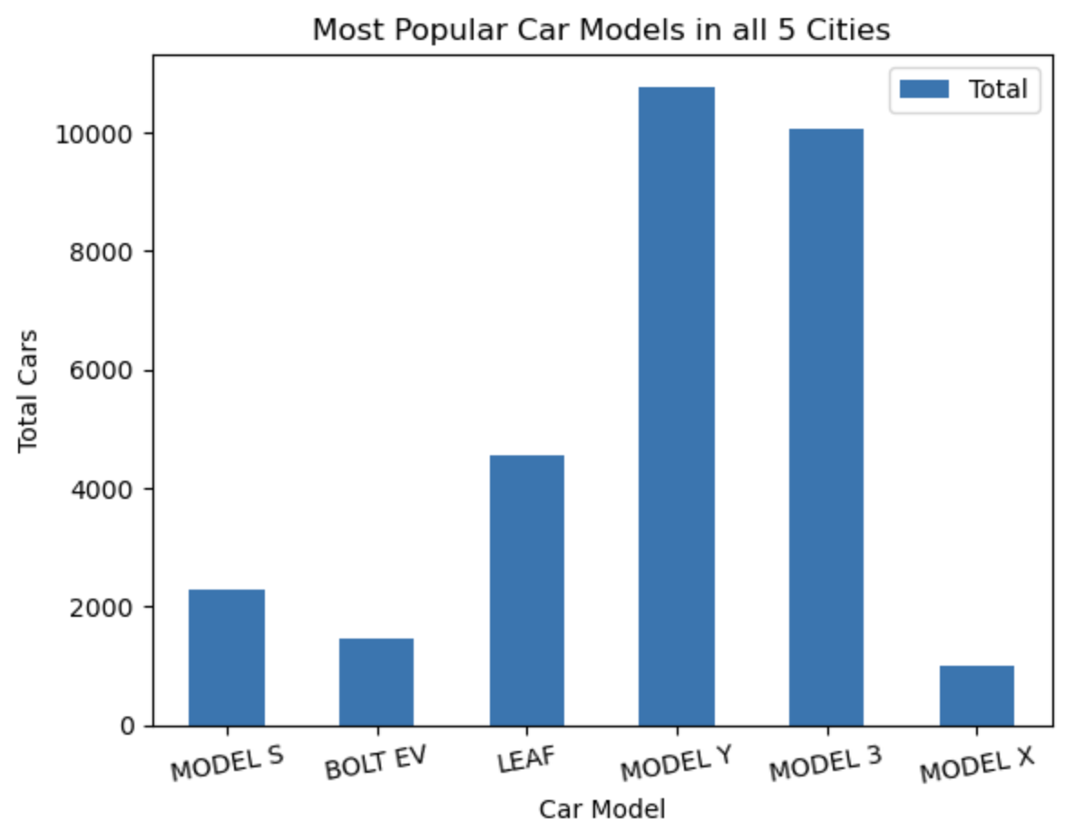
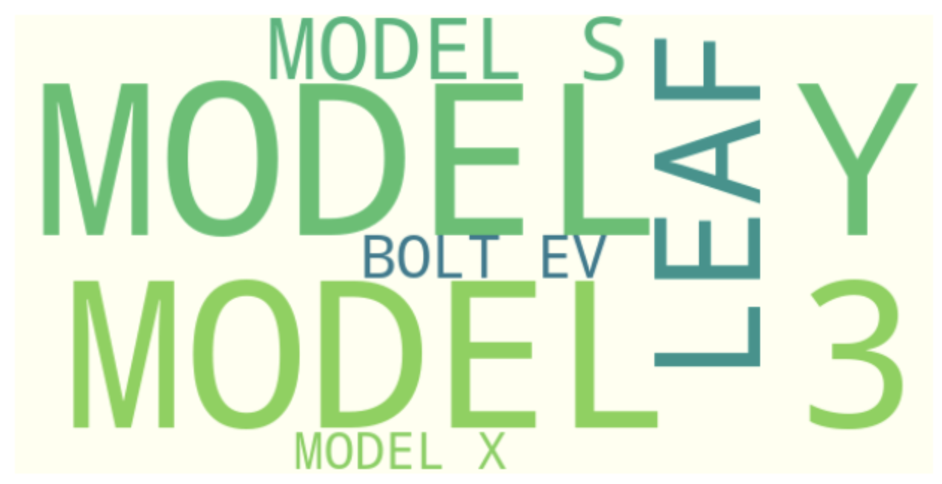
Question 3: What are the most popular car models in the selected cities, and do they have federal incentive?
Notes:
ESHA SPEAKS
I’ll be trying to answer our third sub question was “What are the most popular car models in the selected cities, and do they have federal incentives? Based on our data analysis, the highest car model registered for all 5 cities was Tesla Model Y. We have created wordcloud and a bar chart which both show that Tesla MODEL Y was the most popular followed by Tesla Model 3.

Slide 14
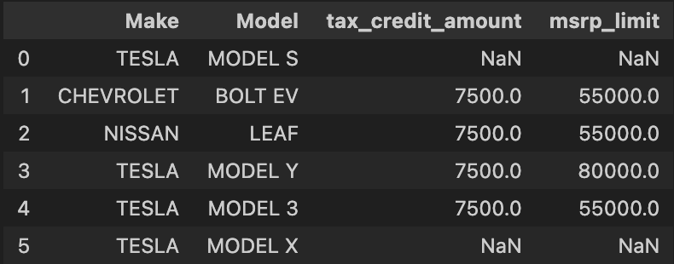
4 out of 6 most popular models qualify for incentives !!
Notes:
ESHA SPEAKS
We had found data for federal incentives and decided to check if the top 6 most popular EV cars in top selected cities received federal rebate. But we have realized that not all EV cars receive federal rebate. However, the most popular car Model Y receives 7500 tax credit amount.

Slide 15
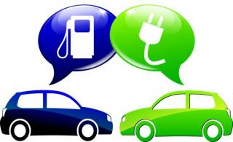
Potential benefits of buying an EV
Electricity Rates more stable than gasoline prices
Grants, Rebates and Tax Credits for EVs & chargers
Lower Longterm costs, with long battery warranties
Cheaper to Charge than to
fill the tank
Free or Reduced Tolls
Notes:
SPEAK ESHA
I’ll be talking about the potential benefits of buying an EV. Electricity rates are more stable than gasoline prices. It’s cheaper to charge than to fill the tank. EVs have lower long-term costs, with long term battery warranties. There are grants, rebates and tax credits for EV cars and Chargers. Evs have free or reduced tolls. I will now be handing it over to Neil to talk about our main question and the limitations.

Slide 16
Is Washington State Ready for the EV Revolution?
No !!!
Notes:
Our research shows that Washington State may not be fully ready for the Electric Vehicle (EV) Revolution right now.
We focused on the top 5 cities with the most registered electric vehicles and found a concerning lack of infrastructure to support widespread EV use.
One main issue is the shortage of charging stations in these cities. Despite more electric vehicles on the road, the current charging infrastructure isn't keeping up with the growing demand.
This lack of charging stations can be a big problem for EV owners, especially for those who can't easily charge near their homes or workplaces.
Our research also indicates that most charging stations are relatively slow. This not only makes using EVs less convenient but could lead to practical issues like not having enough charge when needed. Some people believe that high-speed charging can affect the lifespan of an electric car's battery. However, modern electric vehicles usually have built-in systems to manage charging speed and battery temperature, reducing potential negative impacts.Apart from infrastructure challenges, our analysis stresses the importance of knowing about federal and state incentives when buying an electric vehicle. These incentives can significantly lower the overall cost of owning an EV and make them more financially appealing to consumers.In conclusion, our findings suggest that Washington State might need to invest more in building a strong charging infrastructure to support the increasing number of electric vehicles. Dealing with these infrastructure challenges and making people aware of available incentives is crucial for creating a better environment for the Electric Vehicle Revolution in the state.

Slide 17
Limitations
Limited time and funds:
Restricted the depth and thoroughness of the analysis. Deeper data requires funding which was not needed complete the project.
Challenging data acquisition:
Open source data may be incomplete or outdated, potentially affecting the accuracy of the analysis.
Notes:
Limitations in the research stem from two key factors: limited time and funds, and challenges associated with data acquisition.
The depth and thoroughness of the analysis were constrained by a shortage of time and financial resources.
Comprehensive research often demands significant investments of time and money to gather extensive data, conduct thorough analyses, and ensure the accuracy of findings.
Data acquisition faced challenges, particularly in relying on open-source data.
Open-source data, while valuable, may be incomplete or outdated.
This limitation can compromise the accuracy and relevance of the analysis, as the data used may not fully reflect the current state of the subject under investigation.
Acknowledging these limitations is essential for a balanced understanding of the research findings and suggests areas for improvement in future studies.

Slide 18
QUESTIONS

